Slide 1
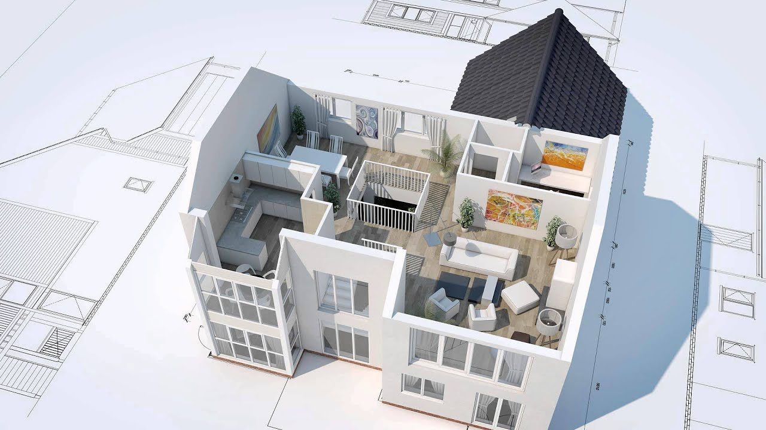
AUTOGENERATION OF 3D MODEL FROM ROOM IMAGES
2016-CE-54
2016-CE-72
2016-CE-81
2016-CS-159

Slide 2
Idea Defence
Supervisor
Dr. Sheikh Faisal Rasheed
Co-Advisor
Mr. Ahmad Awais
Computer Science and Engineering Department, UET, Lahore.

Slide 3
Agenda
Introduction
Problem Statement
Motivation
Objectives
Scope
Target Audience
Existing System
Proposed System
Methodology
Idea Complexity
Possible Applications of Work
Feasibility Study
Market Survey
Limitations and Challenges

Slide 4
1. INTRODUCTION
Overview
Allow users to import the image of 2D floor plan.
Automatically generate 3D model according to 2D floor plan.
Enables users to change the texture of floor and walls in 3D generated model.
Enables users to add furniture in 3D generated model.
The techniques of image processing and model mapping used to generate the 3D computer graphics model
Have different viewpoints i.e. top-view, walk-through, front-view and side-view of 3D generated model.

Slide 5
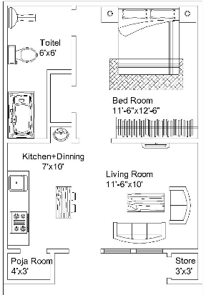
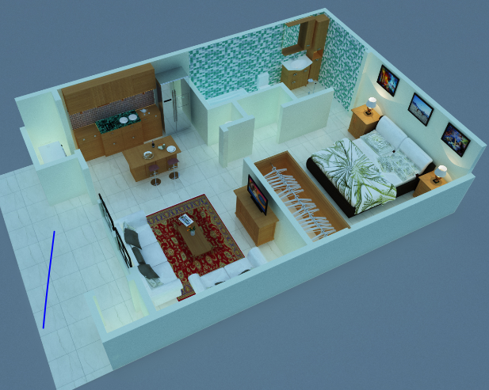

1. INTRODUCTION
Background
Why we need to initiate it?
What problems and needs it will address?

Slide 6

2. PROBLEM STATEMENT
When anyone plans to construct a new at/house and can only see its floor plan. So it's hard for anyone to imagine the actual environment by just seeing 2-D floor plan. So, our system will enable the users to see this 2-D floor plan into 3-D. Our software helps users to edit 3D model quickly without consuming essential resources i.e. time and money.

Slide 7
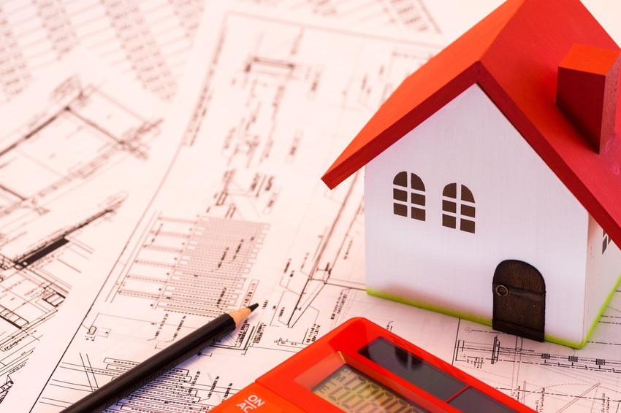
3. MOTIVATION
A common user or an artist who does not know how their home look after construction and proper adjustment of their accessories, it's a big platform for them to see their house in 3D more than their imagination. Already existing such systems can only use by technical users because a lot of manual work is required to construct 3D model from 2D le format. So, this motivates us to automatically generate 3D model from an imported 2D floor plan image by just clicking a button.

Slide 8
4. OBJECTIVES OF PROJECT
Research Objectives
To analyze working different softwares which make 3D models via importing floor plans in different formats as input with high precison and less effort
Academic Objectives
To ensure, that we are implementing our project by using latest technologies which helps students and technical persons to enhance their academic skills via learning and integrating new textures about 3D modelling.
Industrial Objectives
Implement a system that takes into account the demands of industrial artists, home planners and architectural engineers

Slide 9
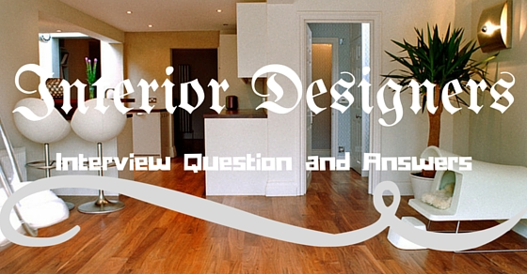
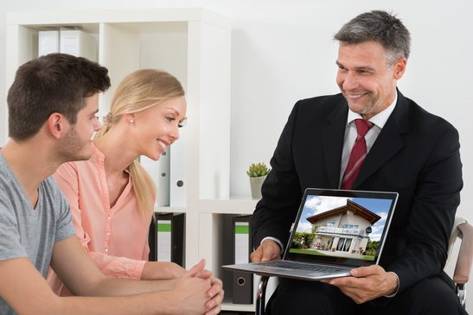

5.SCOPE OF THE PROJECT
This project spread towards house planners, architects and common users who want to make their houses according to their own wish. This project handles les of 2D floor plans in image format (.png and .jpeg),then apply image processing techniques on that 2D floor plan to recognize and generate a 3D model accordingly.

Slide 10
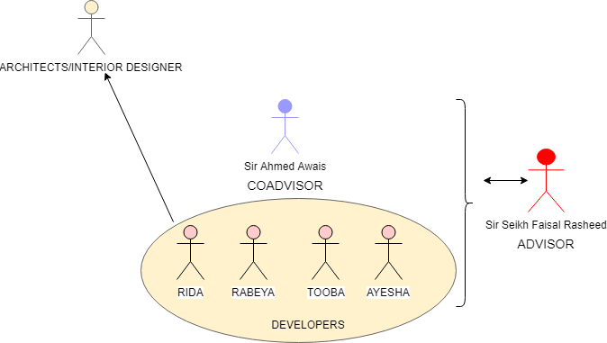
6. METHODOLOGY

Slide 11
6. TARGET AUDIENCE
Common Users
Interior Designers
Architects and Home planners
Real estate sellers agents

Slide 12
7. EXISTING SYSTEM
Sketch Up
SweetHome3D
Blender
Free CAD Software
Solid Works

Slide 13
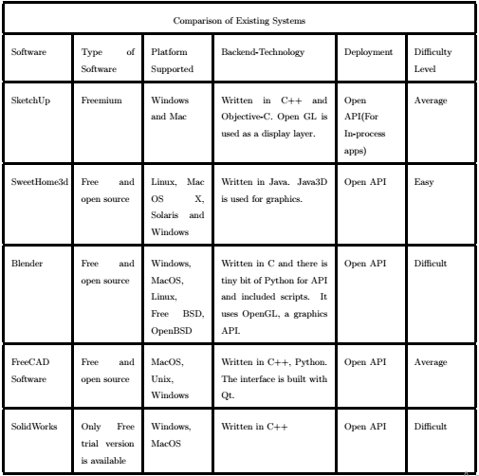
7. EXISTING SYSTEM

Slide 14
7. DRAWBACKS OF EXISTING SYSTEM
Different objective
Manual work
Customized GUI
Time taking
Cost issue
Technical skills required
Input issue

Slide 15
8. PROPOSED SYSTEM
Project Idea
Develop a unity based desktop application
Use python scripts for image processing
Innovation factor
Features
Import 2d floor plan
Generate 3d model
Modify 3d model

Slide 16
9. PROJECT ARCHITECTURE
Read image of 2D floor plan
Object Detector
Wall construction
Object mapping
Floor and ceiling construction.
3D model editor
View of 3D generated model
2D floor plan in image format
External 3D model and texture file

Slide 17
10. IDEA COMPLEXITY
h
Different
Efficient
Complex
How our solution is

Slide 18
11. POSSIBLE APPLICATION OF WORK
Importing of 2D floor plan in image format
Generate 3D model according to imported floor plan
Platform for interior designing of 3D generated model
Platform for architects to generate 3D model efficiently with less time and effort.
Platform for home planners, real estate selling agents to win customer satisfaction and for efficient sales promotions.

Slide 19
12. FEASIBILITY STUDY
Technical Feasibility
Operational Feasibility
Economical Feasibility

Slide 20
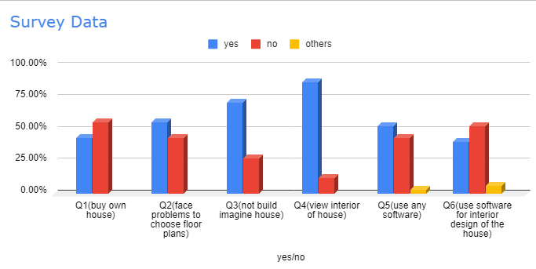
12. FEASIBILITY STUDY

Slide 21
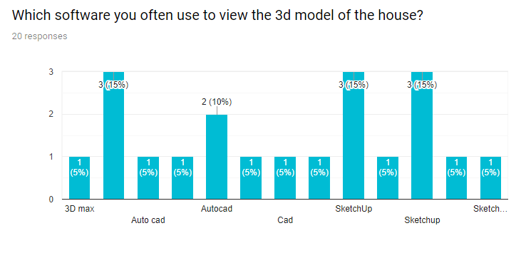
12. FEASIBILITY STUDY

Slide 22
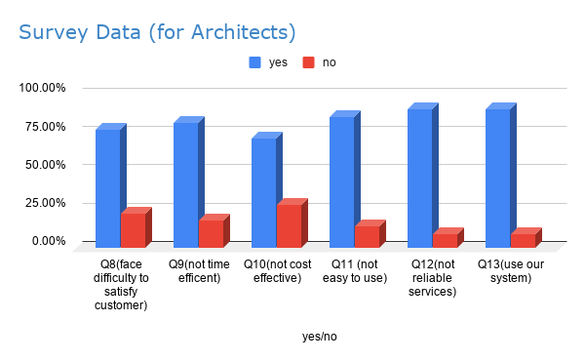
12. FEASIBILITY STUDY

Slide 23
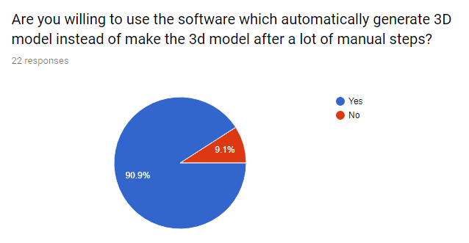
13. MARKET SURVEY

Slide 24
14. LIMITATIONS AND CHALLENGES
Selection of Software and 3D graphic tools
Compatibility of other programming language with graphic tools
Image Processing and recognition
Time Duration
No background of computer graphics
Placing furniture on 3D model according to position and size

Slide 25


